Slide 1
SECOND REVIEW
CLASS:III Bsc computer technology
Date:30.03.2023

Slide 2
MOHAMMED ILIYAS A.S
GUIDE NAME : R.MANIMEGALAI

Slide 3
FINAL SYNOPSIS
The face recognition-based attendance system using Python is a modern approach to automate the attendance recording process.
The system uses a camera to capture images of individuals, and facial recognition algorithms are employed to identify and mark their attendance.
The system maintains a record of attendance, which can be accessed by authorized personnel.

Slide 4
MODULES SPECIFICATIONS:
OpenCV
Face_recognition
Tkinter
Pandas
pillow
Datetime

Slide 5
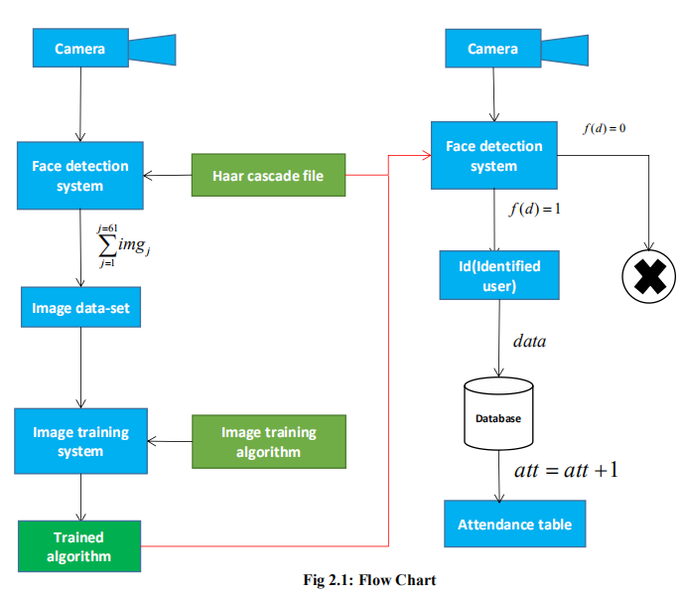
DATA FLOW DIAGRAM
`

Slide 6
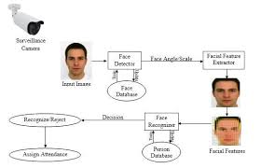
FLOWCHART IN NOWADAYS

Slide 7
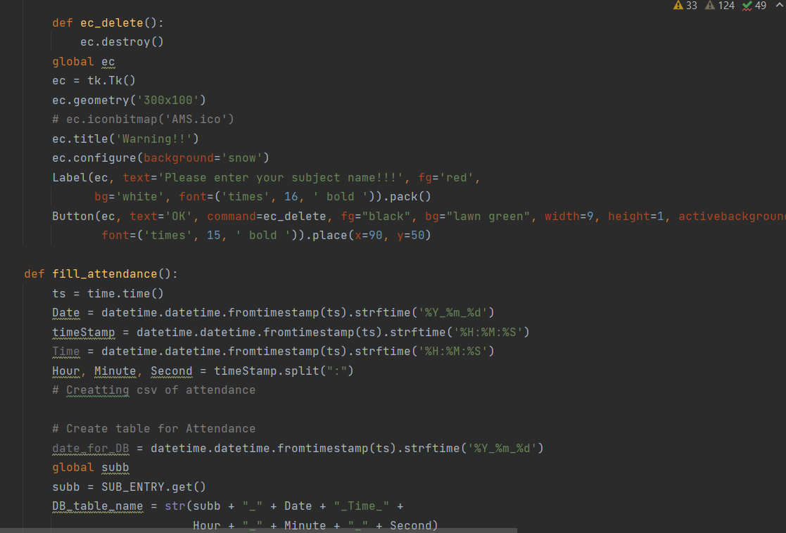
SAMPLE PROGRAM

Slide 8
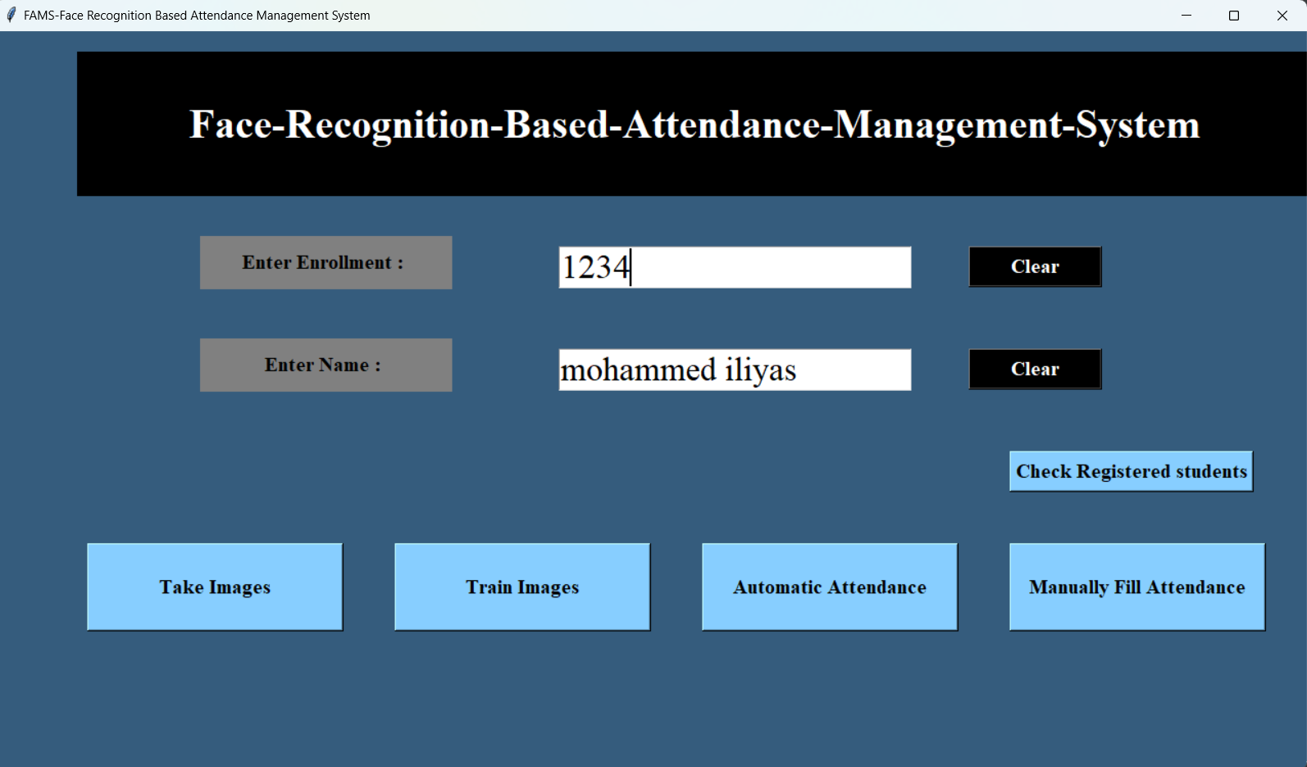
INPUT TESTING

Slide 9
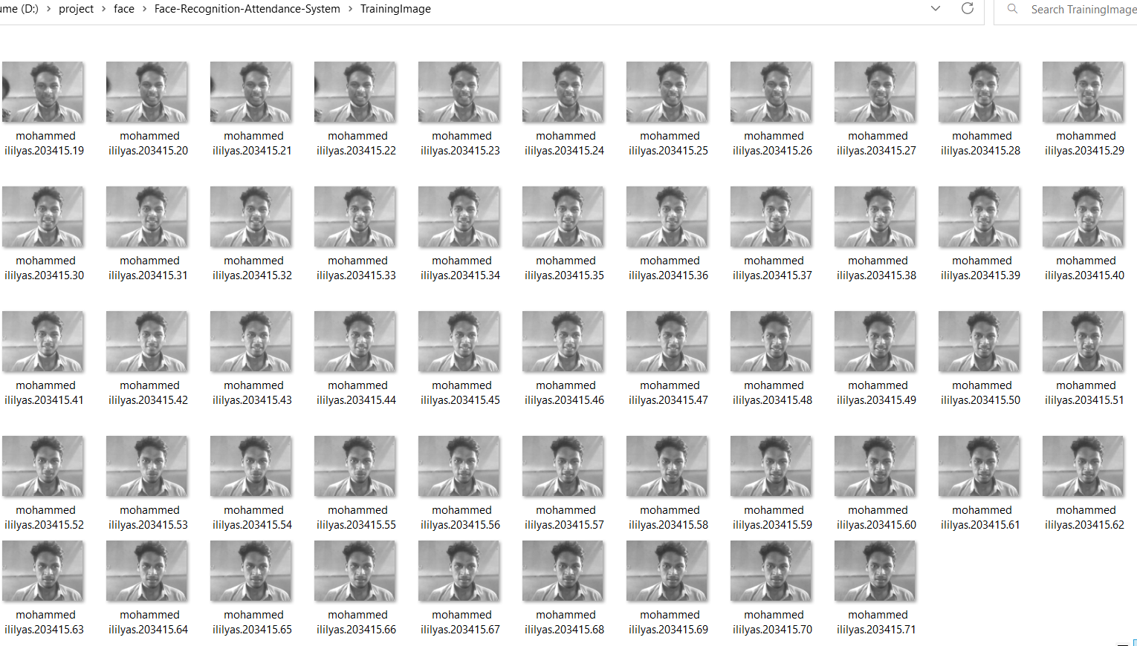
Sample page 1

Slide 10
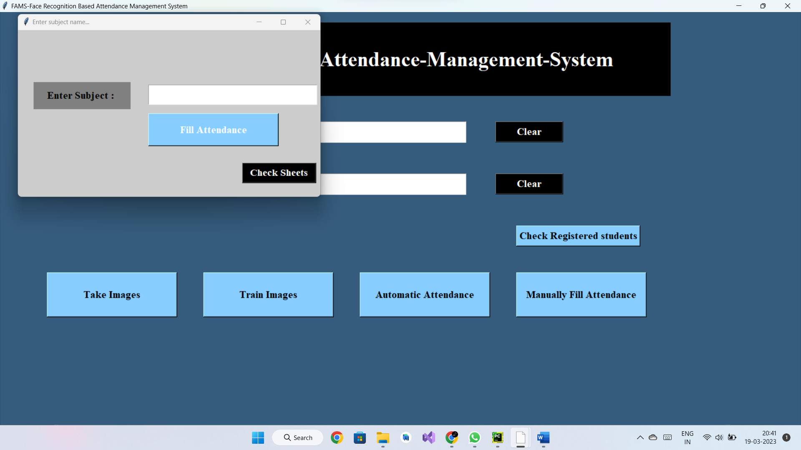
Sample page 2

Slide 11
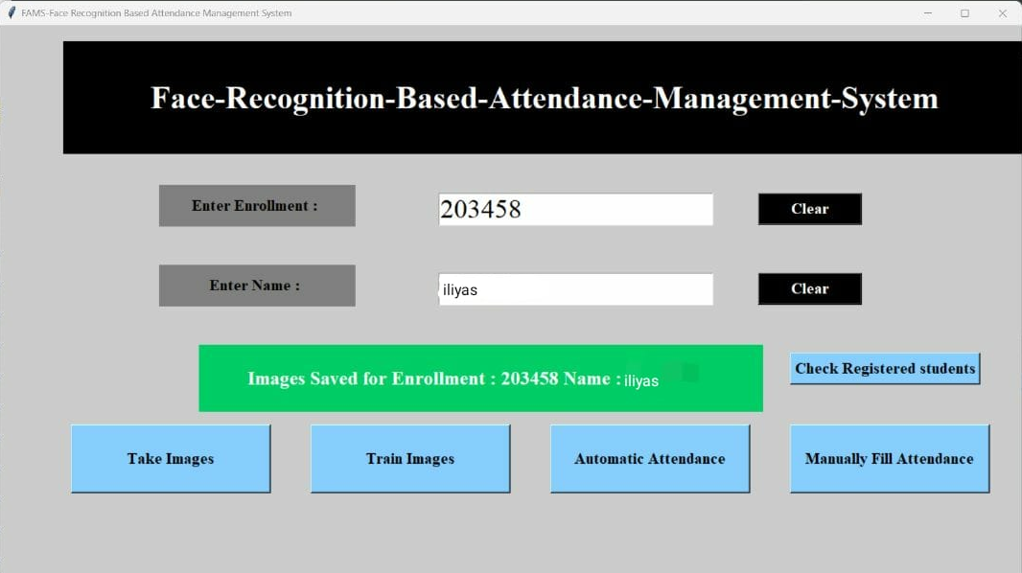
OUTPUT TESTING

Slide 12
THANK YOU
NOTHING IS IMPOSSIBLE

